Slide 1




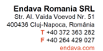
Basic SQL SERVER
Teodora Berende
Proiect cofinantat din Fondul Social European prin Programul Operational Capital Uman 2014-2020

Slide 2


AGENDA
SQL Server
Install SQL Server Management Studio
Connect to a database
Create database
Create tables
Relationships
one-to-many
one-to-one
many-to-many
Database diagram
Run SQL query
Select query
Insert query
Update query
Delete query
Inner join
Write and run a simple procedure
Write and run a simple function
Proiect cofinantat din Fondul Social European prin Programul Operational Capital Uman 2014-2020

Slide 3

SQL SERVER
Proiect cofinantat din Fondul Social European prin Programul Operational Capital Uman 2014-2020

Slide 4
SQL vs SQL SERVER
query language for working with a relational database
create the commands
created by IBM in the 1970s
widely used by other relational databases (there can be little differences in the syntax, but more than 90% is the same through different relational databases)
a relational database management system that performs SQL queries
run the commands
created by Microsoft for commercial use in 1989
other relational databases management systems (or on short - databases): MySQL, PostgreSQL, SQLite
Proiect cofinantat din Fondul Social European prin Programul Operational Capital Uman 2014-2020

Slide 5
SQL
Data Definition Language(DDL)
Create and modify the structure of objects in a database, such as creating the database itself, tables, stored procedures, functions and other database objects.
Data Manipulation Language (DML)
Used to manipulate data by storing, modifying, retrieving and deleting the data in a database.
CRUD operations on data.
Proiect cofinantat din Fondul Social European prin Programul Operational Capital Uman 2014-2020

Slide 6
Install SQL Server Management Studio
LINKS
https://www.microsoft.com/en-us/sql-server/sql-server-downloads
https://learn.microsoft.com/en-us/sql/ssms/download-sql-server-management-studio-ssms?view=sql-server-ver16
https://www.thesagenext.com/support/sql-express-installation
https://www.youtube.com/watch?v=kGdTg-vGs-E
Proiect cofinantat din Fondul Social European prin Programul Operational Capital Uman 2014-2020

Slide 7
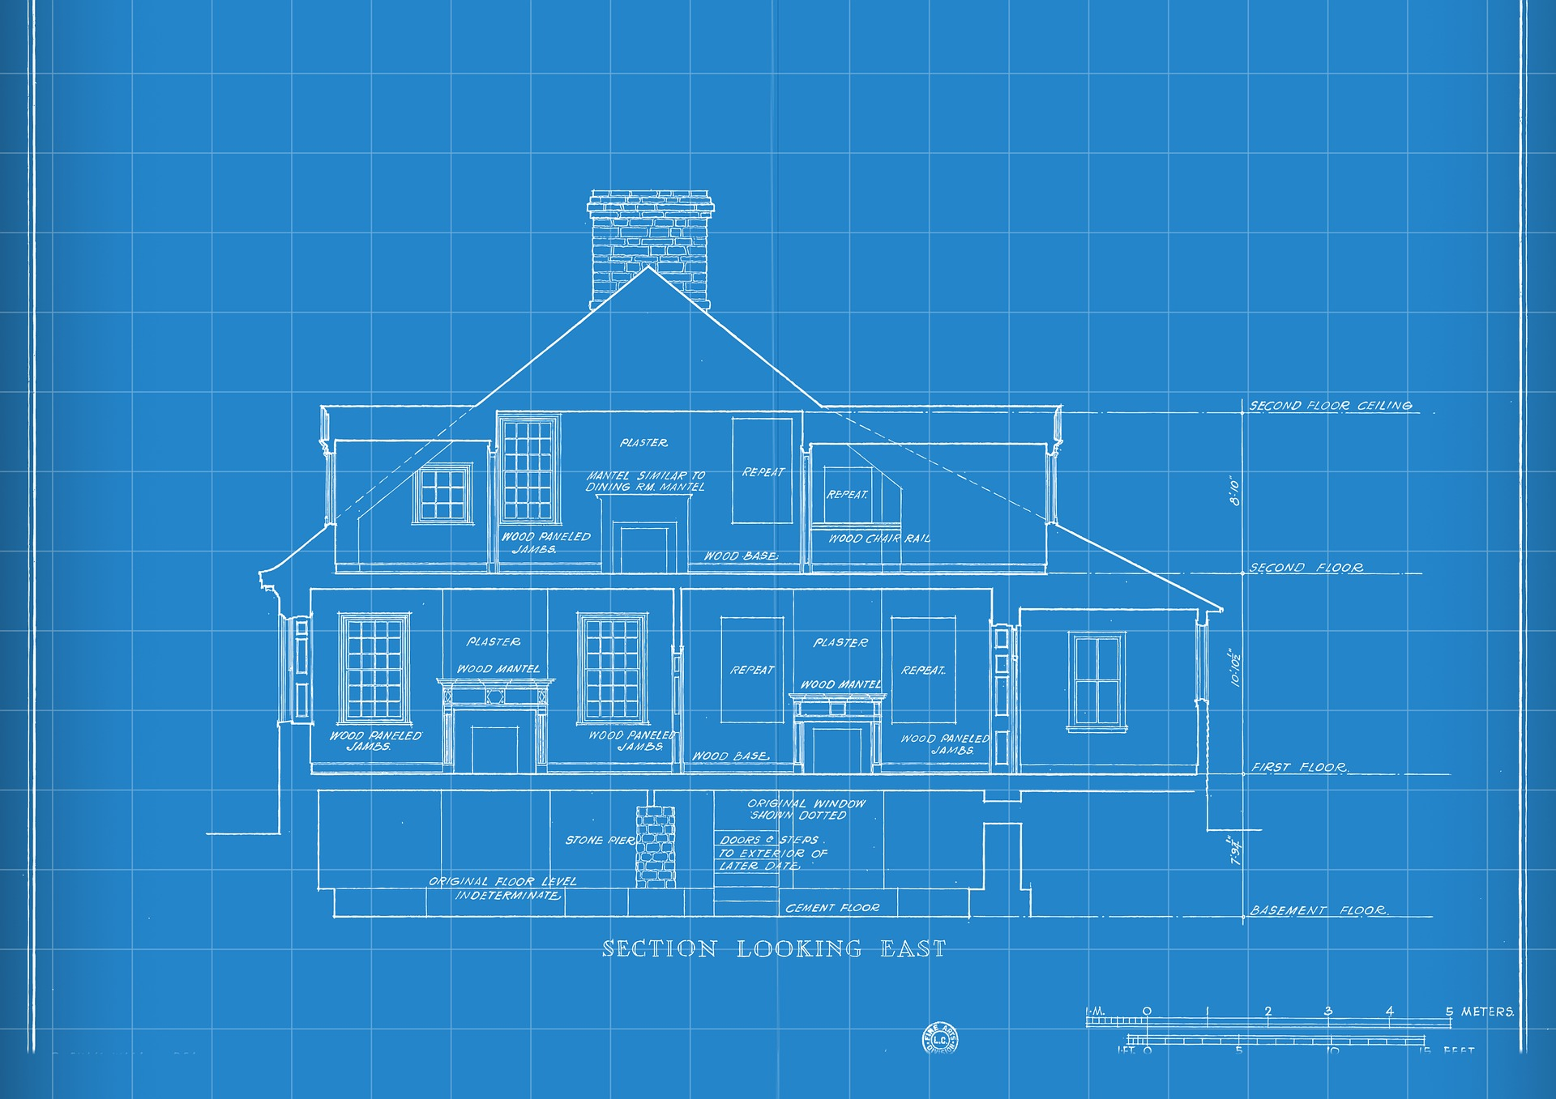
Data Definition Language (DDL)
Proiect cofinantat din Fondul Social European prin Programul Operational Capital Uman 2014-2020

Slide 8


CREATE DATABASE databasename;
DROP DATABASE databasename;
Proiect cofinantat din Fondul Social European prin Programul Operational Capital Uman 2014-2020

Slide 9
CREATE TABLE
CREATE TABLE table_name ( column1 datatype, column2 datatype, column3 datatype, .... );
Proiect cofinantat din Fondul Social European prin Programul Operational Capital Uman 2014-2020

Slide 10
NULL Values
A field with a NULL value is a field with no value.
When creating a table, you can choose if you want to allow NULL values or not.
Proiect cofinantat din Fondul Social European prin Programul Operational Capital Uman 2014-2020

Slide 11
ALTER TABLE (updating a table)
ADD new column
ALTER TABLE table_name ADD column_name datatype;
DELETE column
ALTER TABLE table_name DROP COLUMN column_name;
UPDATE column
ALTER TABLE table_name ALTER COLUMN column_name datatype;
RENAME column
ALTER TABLE table_name RENAME COLUMN old_name to new_name;
Proiect cofinantat din Fondul Social European prin Programul Operational Capital Uman 2014-2020

Slide 12
DROP TABLE
DROP TABLE table_name;
Proiect cofinantat din Fondul Social European prin Programul Operational Capital Uman 2014-2020

Slide 13

RELATIONSHIPS
Proiect cofinantat din Fondul Social European prin Programul Operational Capital Uman 2014-2020

Slide 14

one-to-many (1-m)
Proiect cofinantat din Fondul Social European prin Programul Operational Capital Uman 2014-2020

Slide 15

one-to-one (1-1)
Proiect cofinantat din Fondul Social European prin Programul Operational Capital Uman 2014-2020

Slide 16

many-to-many (m-m)
Image by <a href="https://www.freepik.com/free-vector/hand-drawn-family_720630.htm#query=line%20drawing%20family&position=19&from_view=keyword&track=ais">Freepik</a>
Proiect cofinantat din Fondul Social European prin Programul Operational Capital Uman 2014-2020

Slide 17
Practice TIME
Connect to a database
Create database
Create tables
Relationships
one-to-many
one-to-one
many-to-many
Database diagram
Proiect cofinantat din Fondul Social European prin Programul Operational Capital Uman 2014-2020

Slide 18

Data Manipulation Language (DML) aka QUERIES
Proiect cofinantat din Fondul Social European prin Programul Operational Capital Uman 2014-2020

Slide 19
SELECT STATEMENT read operation
SELECT column1, column2, ... FROM table_name;
Use * for selecting all fields from a table
SELECT * FROM table_name;
Proiect cofinantat din Fondul Social European prin Programul Operational Capital Uman 2014-2020

Slide 20
SELECT STATEMENT with condition
SELECT column1, column2, ... FROM table_name WHERE condition;
Condition can be:
WHERE condition1 AND condition2 AND condition3 ...;
WHERE condition1 OR condition2 OR condition3 ...;
WHERE NOT condition;
Proiect cofinantat din Fondul Social European prin Programul Operational Capital Uman 2014-2020

Slide 21
Test NULL Values
It is not possible to test for NULL values with comparison operators, such as =, <, or <>.
We will have to use the IS NULL and IS NOT NULL operators instead.
WHERE column_name IS NULL;
WHERE column_name IS NOT NULL;
Proiect cofinantat din Fondul Social European prin Programul Operational Capital Uman 2014-2020

Slide 22
SELECT STATEMENT with order of the data
SELECT column1, column2, ... FROM table_name ORDER BY column1, column2, ... ASC|DESC;
Proiect cofinantat din Fondul Social European prin Programul Operational Capital Uman 2014-2020

Slide 23
SELECT STATEMENT
SELECT column1, column2, ... FROM table_name
WHERE condition ORDER BY column1, column2, ... ASC|DESC;
Proiect cofinantat din Fondul Social European prin Programul Operational Capital Uman 2014-2020

Slide 24
INSERT INTO STATEMENT create operation
INSERT INTO table_name (column1, column2, column3, ...) VALUES (value1, value2, value3, ...);
Proiect cofinantat din Fondul Social European prin Programul Operational Capital Uman 2014-2020

Slide 25
UPDATE STATEMENT update operation
UPDATE table_name SET column1 = value1, column2 = value2, ... WHERE condition;
If you forget WHERE clause, you will update all the records of that table!
Proiect cofinantat din Fondul Social European prin Programul Operational Capital Uman 2014-2020

Slide 26
DELETE STATEMENT delete operation
DELETE FROM table_name
WHERE condition;
If you forget WHERE clause, you will delete all the records of that table!
Proiect cofinantat din Fondul Social European prin Programul Operational Capital Uman 2014-2020

Slide 27
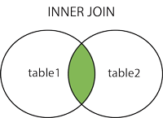
INNER JOIN
The INNER JOIN clause is used to combine rows from two or more tables, based on a related column between them. It selects the records that have matching values in all tables.
Proiect cofinantat din Fondul Social European prin Programul Operational Capital Uman 2014-2020

Slide 28
INNER JOIN
SELECT column_name(s) FROM table1 INNER JOIN table2 ON table1.column_name = table2.column_name;
Proiect cofinantat din Fondul Social European prin Programul Operational Capital Uman 2014-2020

Slide 29
Practice TIME
Run SQL query
Select query
Insert query
Update query
Delete query
Inner join
Proiect cofinantat din Fondul Social European prin Programul Operational Capital Uman 2014-2020

Slide 30
STORED PROCEDURES vs FUNCTIONS
STORED PROCEDURES
Prepared SQL code that you can save, so the code can be reused repeatedly.
Parameters are optional.
Returning a value is optional.
Can modify the data inside of a database.
FUNCTIONS
Prepared SQL code that you can save, so the code can be reused repeatedly.
Must have at least 1 parameter!
Must return a value!
Can’t modify the data inside of a database.
Examples: GETDATE(), COUNT(), SUBSTRING(), STR()
Proiect cofinantat din Fondul Social European prin Programul Operational Capital Uman 2014-2020

Slide 31
STORED PROCEDURE
CREATE PROCEDURE procedure_name AS sql_statement GO;
Execute a stored procedure
EXEC procedure_name;
Proiect cofinantat din Fondul Social European prin Programul Operational Capital Uman 2014-2020

Slide 32
FUNCTION
CREATE FUNCTION function_name (@parameter_name)
RETURNS return_datatype (scalar/table) AS
BEGIN
function_body
RETURN return_datatype
END;
Proiect cofinantat din Fondul Social European prin Programul Operational Capital Uman 2014-2020

Slide 33
Practice TIME
Write and run a simple procedure
Write and run a simple function
Proiect cofinantat din Fondul Social European prin Programul Operational Capital Uman 2014-2020

Slide 34
Q&A
Proiect cofinantat din Fondul Social European prin Programul Operational Capital Uman 2014-2020

Slide 35

THANK YOU
Teodora Berende
teodoraemilia.berende@endava.com
Proiect cofinantat din Fondul Social European prin Programul Operational Capital Uman 2014-2020

